Slide 1
An Inflation Reduction Act Overview
on.mncerts.org/IRA
Notes:
Today we’re going to learn about clean energy incentives for businesses within the Inflation Reduction Act of 2022.
A little background about the Inflation Reduction Act. This bill represents the largest investment into addressing climate change in United States history.
Here the headline: The law is projected to reduce 2030 U.S. greenhouse gas emissions to 40% below 2005 levels. This is a game changer.
The Inflation Reduction Act of 2022 is a landmark federal law which aims to curb inflation by
reducing the deficit,
lowering prescription drug prices, and
investing into domestic energy production while promoting clean energy.
It was passed by Congress and signed into law by President Biden on August 16, 2022.
The law will raise $738 billion and authorize
Nearly 400 billion in spending on energy and climate change initiatives,
More than $200 billion in deficit reduction,
3 years of Affordable Care Act subsidies, prescription drug reform; and more.

Slide 2
Commercial Solar Incentives
Project < 1MW: 30% tax credit
>1 MW: get 30% if meet prevailing wage and apprenticeship requirements
2025: Clean Electricity Investment Credit
Transferability
Notes:
There's been a tax credit for commercial solar on the books for quite a while but it's gone up and down. In fact it was on its way down to only 10% in the next few years. The Inflation Reduction Act changes this. It sets the tax credit at 30% minimum for solar projects that are one megawatt or smaller. If a project is larger than 1 MW, the tax credit is only 6% unless you meet certain prevailing wage and apprenticeship requirements. You can find more details about those requirements on the Clean Energy Resource Teams, or CERTs, Guide to the IRA: https://www.cleanenergyresourceteams.org/inflation-reduction-act-what-you-need-know
Most solar projects have used what is called the investment tax credit or the production tax credit. Those credits go away in 2025 in exchange for a new tax credit called the Clean Electricity Investment Credit which is 30%, but it'll look a lot like an investment tax credit, it'll just be technology neutral. This means it could be used for solar, wind, geothermal, and a whole host of other technologies that do not produce greenhouse gas emissions.
Another new incentive from the Inflation Reduction Act, is transferability — the ability for a company that has put on a solar array, for example, to transfer that tax credit they received for the solar array, to another business. They can sell it. People are anticipating there is going to be a great market for these new tax credits.

Slide 3
Four Tax Credit Adders
Up to 10%: for using US-manufactured solar products and construction material.
Up to 10%: projects in “energy communities”
Up to 10%: solar projects <5MW located in low-income communities
Up to 20%: solar projects < 5MW, built as part of an affordable housing project or to benefit low-income HH
Notes:
Another new incentive from the Inflation Reduction Act are what are called "adders."
The tax credit is a minimum of 30 percent, and if you do a certain number of things, that tax credit could be even bigger.
For example if your solar array uses made in America domestic content, arrays, solar panels, and products, that's a 10% adder to you 30% tax credit, putting you at 40% tax credit.
If your array is located in an "energy community," this could be a brownfield site, or a location, a city that is heavily dependent on fossil fuels/of the fossil fuel industry, that's another 10% adder.
If it's located in a low-income community, again a 10% adder.
If it is part of an affordable housing project, or if it benefits low-income households that adder could be 20%. It's important to note that projects located in low-
income communities, or are part of an affordable housing project, or benefit low-income individuals, need to apply to receive this additional tax credit.
Theoretically, the final tax credit could be as much as 70%. That's a real game changer when you think about where we were with the tax credit ramping down from 30%, 26%, 22%, down to 10%, to now potentially, as much as a 70% tax credit for these projects.

Slide 4
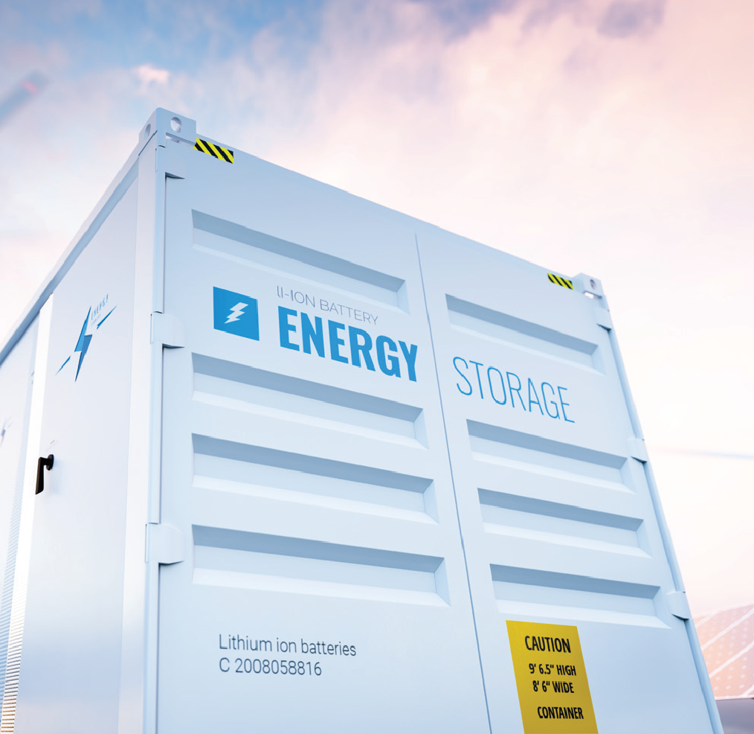
And Storage!
The most important change for the energy storage industry is that standalone energy storage assets are now eligible for the investment tax credit (ITC).
Image source: Institute on the Env Community Scale Energy Storage Guide
Notes:
Another new incentive is for energy storage batteries. Previously in order for energy storage batteries to be eligible for a tax credit, they needed to be tied into a solar array. With the Inflation Reduction Act, they can now be standalone and qualify for the investment tax credit. Meaning if you're a hospital, if you're a data center, if battery storage is really important for you for whatever reason you want energy storage, you can now take advantage of this tax credit.

Slide 5
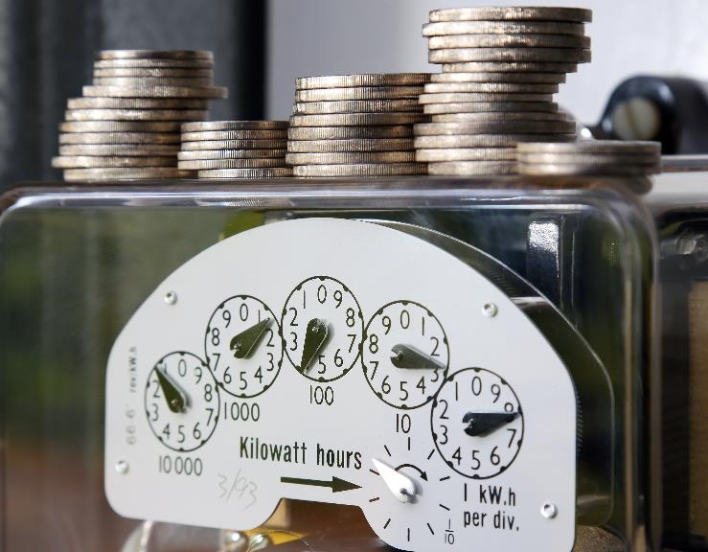
Visit the CERTs Guide to the Inflation Reduction Act to learn more:
on.mncerts.org/IRA
Notes:
The Clean Energy Resource Teams share tools and resources to keep you informed on how to save energy and money with energy efficiency methods and clean energy options. Visit their Guide to the Inflation Reduction Act for updates to help you take advantage of the clean energy incentives within the bill: https://www.cleanenergyresourceteams.org/inflation-reduction-act-what-you-need-know
Thank you, this is the end of the Commercial Solar + Storage presentation.
Please note: We're sharing resources to assist Minnesotans who are seeking information about federal funding opportunities. These resources are based on preliminary information released by the federal government. Program information may change as more guidance is provided by federal and state governments. For specific information on federal funding, please visit the relevant U.S. Government websites and consult with tax professionals regarding tax incentives that apply to you.

