Slide 1
An Inflation Reduction Act Overview
on.mncerts.org/IRA
Notes:
Today we’re going to learn how Direct Pay can allow tax-exempt entities to take advantage of the Inflation Reduction Act of 2022.
A little background about the Inflation Reduction Act. This bill represents the largest investment into addressing climate change in United States history.
Here the headline: The law is projected to reduce 2030 U.S. greenhouse gas emissions to 40% below 2005 levels. This is a game changer.
The Inflation Reduction Act of 2022 is a landmark federal law which aims to curb inflation by
reducing the deficit,
lowering prescription drug prices, and
investing into domestic energy production while promoting clean energy.
It was passed by Congress and signed into law by President Biden on August 16, 2022.
The law will raise $738 billion and authorize
Nearly 400 billion in spending on energy and climate change initiatives,
More than $200 billion in deficit reduction,
3 years of Affordable Care Act subsidies, prescription drug reform; and more.

Slide 2
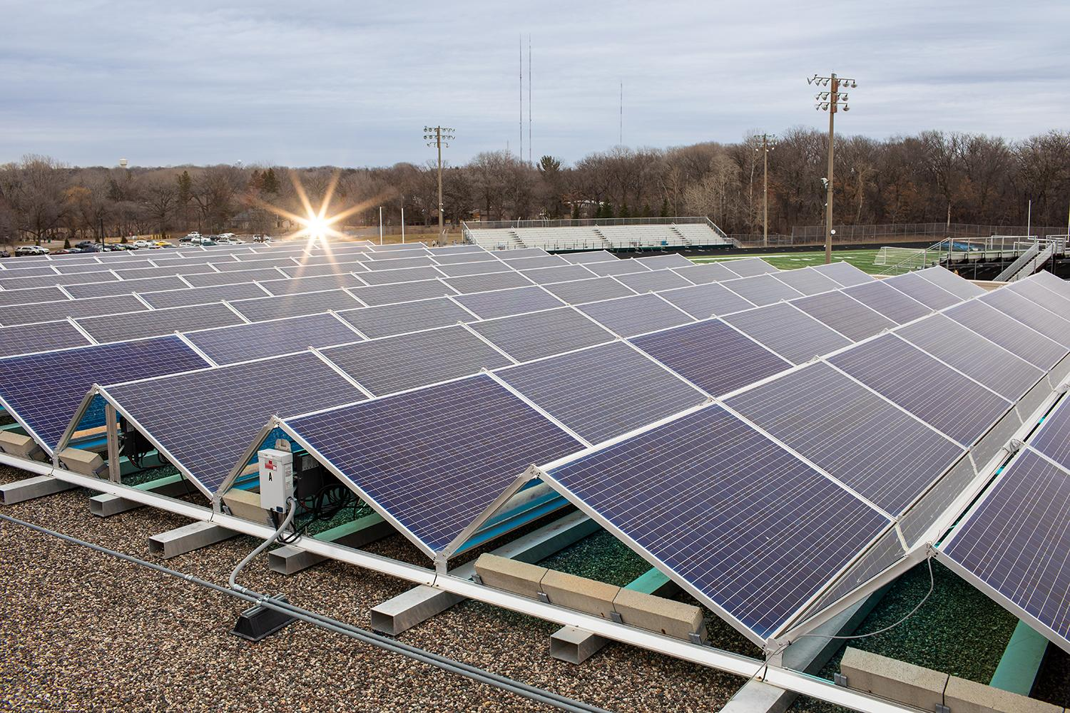
Direct Pay provisions
Direct pay allows tax-exempt entities to take advantage of new tax incentives.
They can receive a “direct payment” rather than having to work with a tax equity partner.
Eligible technologies include: solar, storage, geothermal, combined heat and power, even commercial clean vehicles
Cities, counties, townships
Tribal nations
Non-profits
Faith communities
Cooperative and Municipal Utilities
Other governmental entities
Notes:
So you're a non-profit, or a city, or a county, or a school, you're a non-tax-paying entity and you're interested in doing a renewable energy project or purchasing an electric vehicle. That's fantastic! The Inflation Reduction Act has a new tool that you can tap into called Direct Pay. It's amazing!
30% of your project can be paid for via the federal government through this direct pay option.
Typically these projects have been paid for in the past through tax equity partners, and you can still do that if that's the way that you wish to go. However you can own, in this case solar for example, you can own it outright from day one and get 30% of it paid for through the federal government.
Eligible technologies include solar, storage, geothermal, combined heat and power, even clean commercial vehicles or EVs.
You can get up to $7,500 dollars for a car, or up to $40,000 for an SUV, truck, or van through this direct pay option.

Slide 3
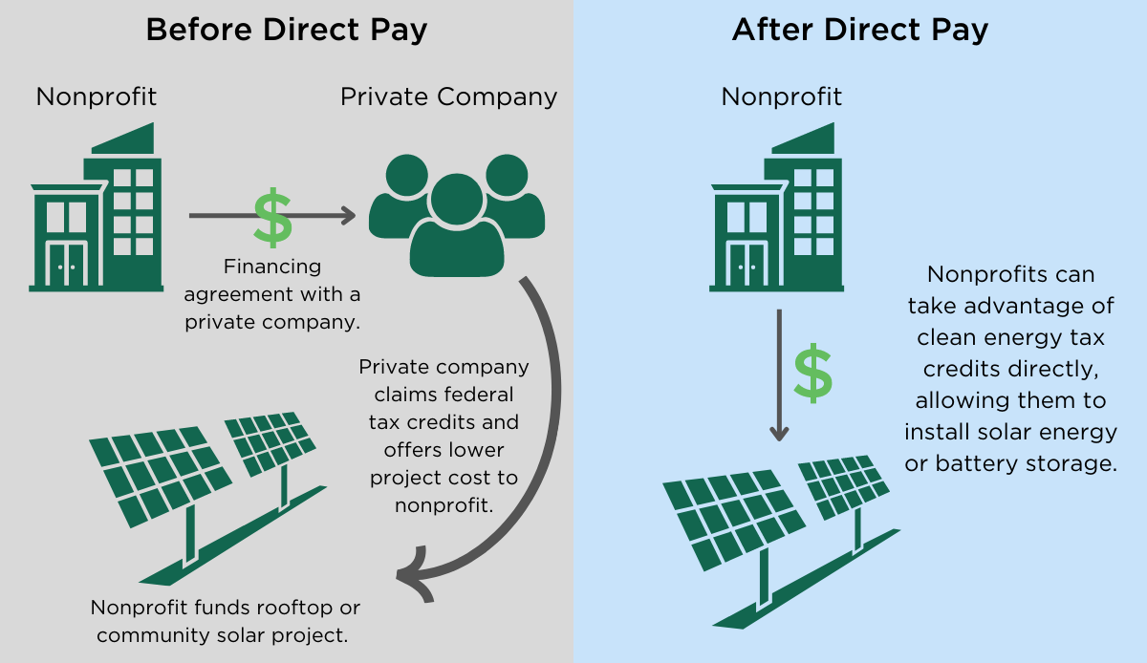
How Direct Pay Works
Visual courtesy of the Environmental and Energy Study Institute
Notes:
Here’s a visual from the Environmental and Energy Study Institute on how direct pay works.

Slide 4
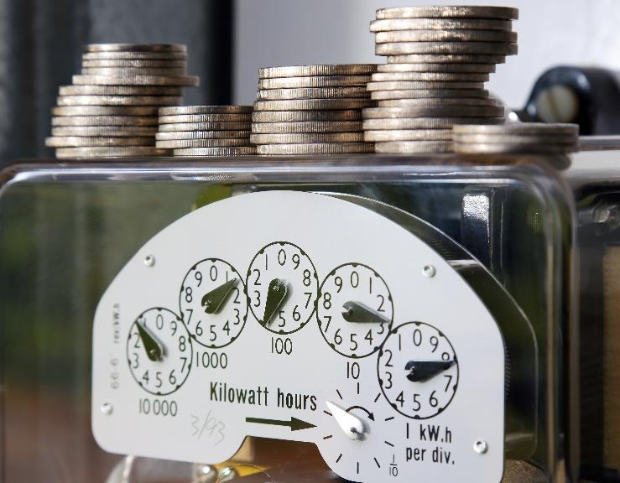
Visit the CERTs Guide to the Inflation Reduction Act to learn more:
on.mncerts.org/IRA
Notes:
The Clean Energy Resource Teams share tools and resources to keep you informed on how to save energy and money with energy efficiency methods and clean energy options. Visit their Guide to the Inflation Reduction Act for updates to help you take advantage of the clean energy incentives within the bill: https://www.cleanenergyresourceteams.org/inflation-reduction-act-what-you-need-know
Thank you, this is the end of the Direct Pay presentation.
Please note: We're sharing resources to assist Minnesotans who are seeking information about federal funding opportunities. These resources are based on preliminary information released by the federal government. Program information may change as more guidance is provided by federal and state governments. For specific information on federal funding, please visit the relevant U.S. Government websites and consult with tax professionals regarding tax incentives that apply to you.

