Slide 1
An Inflation Reduction Act Overview
on.mncerts.org/IRA
Notes:
Today we’re going to talk about how the Inflation Reduction Act can save you money through tax credits if you purchase a new or pre-owned electric vehicle, or EV.
A little background about the Inflation Reduction Act. This bill represents the largest investment into addressing climate change in United States history.
Here the headline: The law is projected to reduce 2030 U.S. greenhouse gas emissions to 40% below 2005 levels. This is a game changer.
The Inflation Reduction Act of 2022 is a landmark federal law which aims to curb inflation by
reducing the deficit,
lowering prescription drug prices, and
investing into domestic energy production while promoting clean energy.
It was passed by Congress and signed into law by President Biden on August 16, 2022.
The law will raise $738 billion and authorize
Nearly 400 billion in spending on energy and climate change initiatives,
More than $200 billion in deficit reduction,
3 years of Affordable Care Act subsidies, prescription drug reform; and more.

Slide 2
EV Incentives shifting
Beginning 2023: Income Qualified HH may qualify for tax credits up to $7,500
New: Used EVs Incentive:
Income Qualified households can receive a tax credit of up to $4,000
Vehicle must be 2 years old
Cost < $25,000
Conditions:
Assembled in North America.
Meets battery components requirements.
Meets critical minerals requirement.
Visit: on.mncerts.org/IRA for resources with more info.
Notes:
So you're in the market for an electric vehicle, (all-electric, plug-in hybrid, and fuel cell electric vechiles) or EV? That's fantastic! The Inflation Reduction Act can help you out. For income-qualified households, there’s a tax credit for up to $7,500 for new qualified EVs, and a $4,000 tax credit for qualified pre-owned or used EVs purchased after January 1, 2023. Upcoming state and local tax incentives may also apply.
The requirements for what a new vehicle must have in order to qualify for the tax credit, have been updated in April 2023. The Clean Energy Resources Teams, or CERTs, have links to the most up to date resource for finding out if the vehicle you’re considering purchasing, qualifies for the full tax credit or a partial tax credit. They also link to the Used Clean Vehicle Credit which will show you which pre-owned vehicles are eligible for that tax credit. As things change, CERTs posts updates on their Guide to the Inflation Reduction Act: https://www.cleanenergyresourceteams.org/inflation-reduction-act-what-you-need-know

Slide 3
2023 Incentive Details
Income Qualified:
Married couples making < $300,000
Single people making < $150,000
EV complies with pricing requirements:
Less than $80,000 for SUV, pickup trucks, vans.
Less than $55,000 for all other vehicles
Notes:
In order for your household to qualify for the tax incentives, married couples filing jointly must make less than $300,000, heads of household must make less than $225,000, and all other filers must make less than $150,000 in order to be income qualified for these EV tax credits.
There are pricing requirements of the EV as well. Vans, SUVs, and pickup trucks must not cost more than $80,000. Other vehicles must cost less than $55,000.

Slide 4
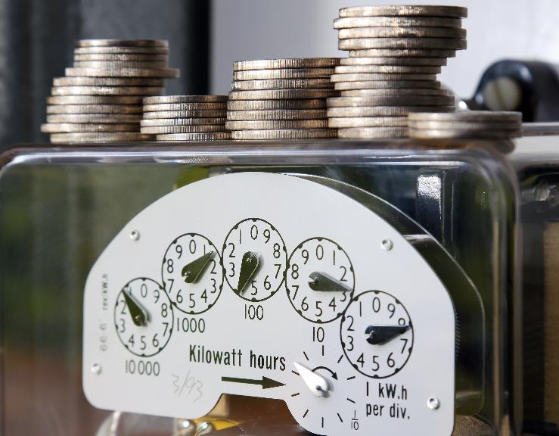
Visit the CERTs Guide to the Inflation Reduction Act to learn more:
on.mncerts.org/IRA
Notes:
The Clean Energy Resource Teams share tools and resources to keep you informed on how to save energy and money with energy efficiency methods and clean energy options. Visit their Guide to the Inflation Reduction Act for updates to help you take advantage of the clean energy incentives within the bill: https://www.cleanenergyresourceteams.org/inflation-reduction-act-what-you-need-know
Thank you, this is the end of the Electric Vehicle Incentives presentation.
Please note: We're sharing resources to assist Minnesotans who are seeking information about federal funding opportunities. These resources are based on preliminary information released by the federal government. Program information may change as more guidance is provided by federal and state governments. For specific information on federal funding, please visit the relevant U.S. Government websites and consult with tax professionals regarding tax incentives that apply to you.

