Slide 1

An Inflation Reduction Act Overview
on.mncerts.org/IRA
Notes:
Today we’re going to learn how different household sizes and incomes could take advantage of the clean energy incentives within the Inflation Reduction Act of 2022.
A little background about the Inflation Reduction Act. This bill represents the largest investment into addressing climate change in United States history.
Here the headline: The law is projected to reduce 2030 U.S. greenhouse gas emissions to 40% below 2005 levels. This is a game changer.
The Inflation Reduction Act of 2022 is a landmark federal law which aims to curb inflation by
reducing the deficit,
lowering prescription drug prices, and
investing into domestic energy production while promoting clean energy.
It was passed by Congress and signed into law by President Biden on August 16, 2022.
The law will raise $738 billion and authorize
Nearly 400 billion in spending on energy and climate change initiatives,
More than $200 billion in deficit reduction,
3 years of Affordable Care Act subsidies, prescription drug reform; and more.

Slide 2

Case Study: The Coleman Family
The Colemans are a family of five outside of New London, MN.
They own a 1,300-square-foot, 3-bedroom home built in 1966, and heat it with propane.
They have an annual household income of $55,000, which is under 80 percent of the Area Median Income.
They qualify for up-front discounts that can cover 100 percent of their electrification costs up to $14,000.
Notes:
This is the Coleman family, from New London. They own a 1300 square foot three bedroom home built in the mid-1960s and they heat it with propane. They have an annual income of $55,000 which is under the 80% Area Median Income for New London, which is approximately $83,000.
The Coleman family qualifies for upfront discounts, point of sale rebates, up to 100% covered for the home improvements that they need to make.

Slide 3
The Colemans IRA Journey
Year | Replacing | Buying | Est. Cost, installed | Upfront Discount | 30% Tax Credit | Final Cost
2023 | Propane Range | Electric Range | $749 | -$749 (HEEHRA) |  | $0
 | Old Wiring | Electric Wiring | $1,500 | -$1,500 (HEEHRA) |  | $0
2024 | Tank Propane Water Heater | Heat Pump Water Heater | $3,000 | -$1,750 (HEEHRA) | -$375 (25C) | $875
2025 |  | Weatherization | $1,600 | -$1,600 (HEEHRA) |  | $0
 | Window AC Unit | Ducted Mini-Split Heat Pump | $7,500 | -$7,500 (HEEHRA) |  | $0
 | Propane Clothes Dryer | Heat Pump Clothes Dryer | $798 | -$798 (HEEHRA) |  | $0
2027 | Gas Car | Used EV | $14,000 | -$4,000 (25E) |  | $10,000
Total |  |  | $29,174 | -$17,897 | -$375 | $10,075
Notes:
This chart shows what those improvements may be over the next several years for the Coleman family. This year they're in the market for a new stove. They have a propane range, they want to buy an electric range or an induction range. 100% of the cost is covered thanks to HEEHRA.
In a few years they're looking to get rid of their gas car and they want to buy a used EV (electric vehicle). They would qualify for $4,000 tax credit for a qualified used EV. Maybe they're buying a used Nissan Leaf for fourteen thousand dollars, they could get a four thousand dollar tax credit for that purchase.

Slide 4
Case Study: The Garcia Family
The Garcias are a family of five in Worthington, MN.
They own a 1,600-square-foot, 4-bedroom home built in 1972, and heat it with natural gas.
They have an annual household income of $115,000, which is just under 150% of the Area Median Income.
They qualify for up-front discounts that can cover 50% of their electrification costs up to $14,000.
Notes:
Next is the Garcia family in Worthington. A family of five who own a 1600 square foot, four bedroom home built in the early 1970s, heated with natural gas. Their income is $115,000, which for the Worthington area is below the 150% Area Median Income (AMI for Worthington is $83,000). They qualify for 50% rebate discounts on their electrification costs, with a maximum of $14,000 in rebates.

Slide 5
The Garcia Family IRA Journey
Year | Replacing | Buying | Est. Cost, installed | Upfront Discount | 30% Tax Credit | Final Cost
2023 | Gas Car | Used EV | $17,000 |  | -$4,000 | $13,000
 |  | EV Charger | $1,200 |  | -360 (30C) | $840
 | 60A Electric Panel | 200A Electric Panel | $2,000 | -$1,000 (HEEHRA) | -$300 (25C) | $700
 |  | Electric Wiring | $2,500 | -$1,250 (HEEHRA) |  | $1,250
2024 | Gas Range | Induction Range | $1,300 | -$650 (HEEHRA) |  | $650
2026 |  | Weatherization | $1,600 | -$800 (HEEHRA) |  | $800
 | Gas Furnace & Central AC Unit | Central Heat Pump | $12,000 | -$6,000 (HEEHRA) | -$1,800 | $4,200
2028 |  | Rooftop Solar | $19,000 |  | -$5,700 (25D) | $13,300
Total |  |  | $59,600 | -$11,200 | -$12,610 | $34,990
Notes:
The Garcia family wants to get rid of their gas car and buy a used EV, $17,000 with $4,000 tax credit. Throughout the years they're looking for a new stove, new furnace, and they want a solar array on their home, 30% tax credit for that new solar array in 2028 for the Garcia family.

Slide 6
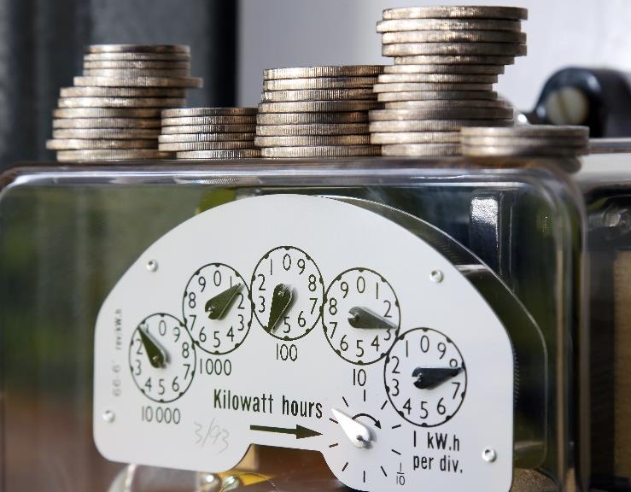

Visit the CERTs Guide to the Inflation Reduction Act to learn more:
on.mncerts.org/IRA
Notes:
The Clean Energy Resource Teams share tools and resources to keep you informed on how to save energy and money with energy efficiency methods and clean energy options. Visit their Guide to the Inflation Reduction Act for updates to help you take advantage of the clean energy incentives within the bill: https://www.cleanenergyresourceteams.org/inflation-reduction-act-what-you-need-know
Thank you, this is the end of the Household Scenarios presentation.
Please note: We're sharing resources to assist Minnesotans who are seeking information about federal funding opportunities. These resources are based on preliminary information released by the federal government. Program information may change as more guidance is provided by federal and state governments. For specific information on federal funding, please visit the relevant U.S. Government websites and consult with tax professionals regarding tax incentives that apply to you.

