Slide 1
An Inflation Reduction Act Overview
on.mncerts.org/IRA
Notes:
Today we’re going to learn how the Inflation Reduction Act of 2022 can save you money through tax credits and rebates, when you apply energy efficiency methods or upgrade to clean energy technologies within your home.
A little background about the Inflation Reduction Act. This bill represents the largest investment into addressing climate change in United States history.
Here the headline: The law is projected to reduce 2030 U.S. greenhouse gas emissions to 40% below 2005 levels. This is a game changer.
The Inflation Reduction Act of 2022 is a landmark federal law which aims to curb inflation by
reducing the deficit,
lowering prescription drug prices, and
investing into domestic energy production while promoting clean energy.
It was passed by Congress and signed into law by President Biden on August 16, 2022.
The law will raise $738 billion and authorize
Nearly 400 billion in spending on energy and climate change initiatives,
More than $200 billion in deficit reduction,
3 years of Affordable Care Act subsidies, prescription drug reform; and more.

Slide 2
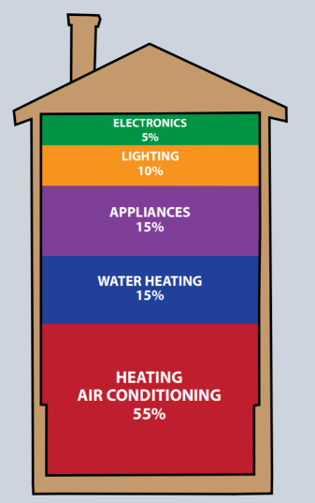
Top energy savings opportunities
Tip: Get an energy audit
Contact your utility to get an energy audit to find out exactly what energy savings you can find at your home!
Attic Insulation
Heating System
Wall Insulation
Windows
Other Appliances
Notes:
This is a slide that the Clean Energy Resource Teams, or CERTs, has been using for years. It is all about the things people can do in their own homes to be more energy efficient. And the great news is, the Inflation Reduction Act really taps into all of these energy saving opportunities with tax credits and rebates.
The first thing to consider is an energy audit for your home. If you're in Xcel Energy territory or Center Point Energy territory, the Home Energy Squad is the provider of these home energy audits. If you're outside of those territories, contact your utility. They'll be able to point you in the right direction. If you have to pay for your home energy audit, you may capture a 30% tax credit, up to $150 through the Inflation Reduction Act. Learn more about Home Energy Audits, and DIY options from CERTs: cleanenergyresourceteams.org/energy-assessment-benchmarking

Slide 3
Tax Credits on these measures!
Maximum Annual Cap: $3,200
Up to 30% tax credit; max amount listed by technology.
Home Energy Audit: up to $150
Attic Insulation & Wall Insulation: up to $1,200
Heating System: for heat pumps: $2,000
Windows: $600
Doors: $250/door, up to $500
Other Appliances: water heaters: $600
(or if a heat pump water heater: $2,000)
Tip: You can get a credit every year; so you could stage your projects to maximize your benefits.
Notes:
Tax credits for energy efficiency have been around for quite a while. Before the Inflation Reduction Act there was a lifetime cap or $500 for energy efficiency tax credits. Now with the Inflation Reduction Act, the cap has changed to $3,200 annually. It’s broken down into a $1,200 maximum annual tax credit for building envelope type improvements, such as windows, doors, insulation, and electrical, plus eligible furnaces, boilers, and central air conditioners. And a $2,000 annual tax credit cap for any combination of air source heat pumps, heat pump water heaters, and biomass stoves or boilers. The Department of Energy created a Savings Hub for Homeowners to help you determine what qualifies for this credit and how to receive the credit, and all other energy efficiency tax credits, when you file your taxes: https://www.energy.gov/save/homeowners

Slide 4
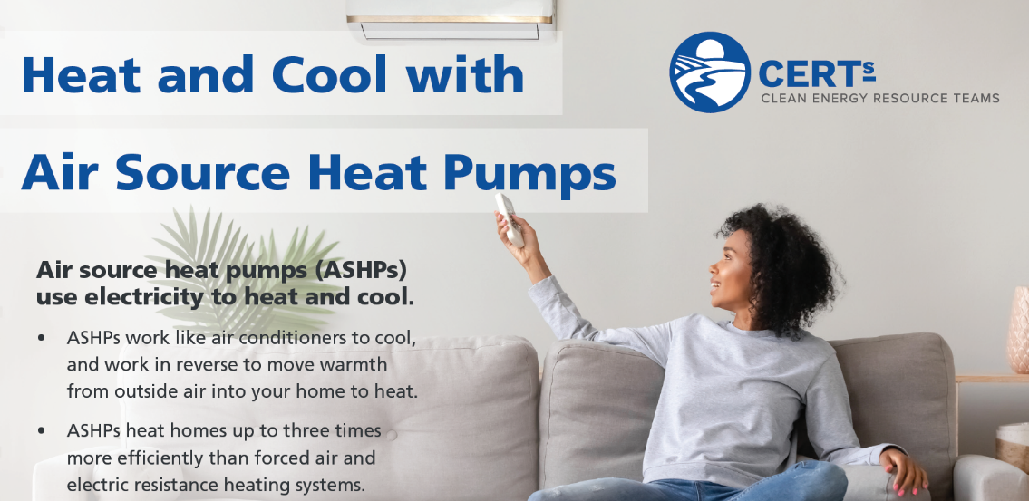
For example: Heat pumps
$2,000 tax credit!
Notes:
One example of these energy efficient technologies is air source heat pumps. They transfer hot and cold air, instead of creating it. They cool your home in the summer, similar to how your refrigerator keeps your food cold, and they heat in the winter by efficiently transferring warm air back into your home. With technological advances air source heat pumps are practical appliances for our northern climate. And you can receive a 30% tax credit, up to $2,000, for a qualified air source heat pump. CERTs shares more information on how air source heat pumps work, and what you should consider before purchasing one: cleanenergyresourceteams.org/ashp

Slide 5
MN awaiting DOE Guidance for Key Residential Rebate Programs
Program | IRA Funding Level | Timeline
Home Owner Managing Energy Savings (HOMES) Rebates | $4.3 B | Available through 2031
High-Efficiency Electric Home Rebate Program | $4.5 B | Available through 2031
Notes:
Rebates through the Inflation Reduction Act are on their way. Currently the State of Minnesota is putting a plan together on how the rebates will be distributed. The rollout is expected later in 2023 or the beginning of 2024.
The two rebate programs are the Home Owner Managing Energy Savings Rebate, or the HOMES Rebate program. And the High-Efficiency Electric Home Rebate Act program, or HEEHRA (pronounced, here-ah).

Slide 6
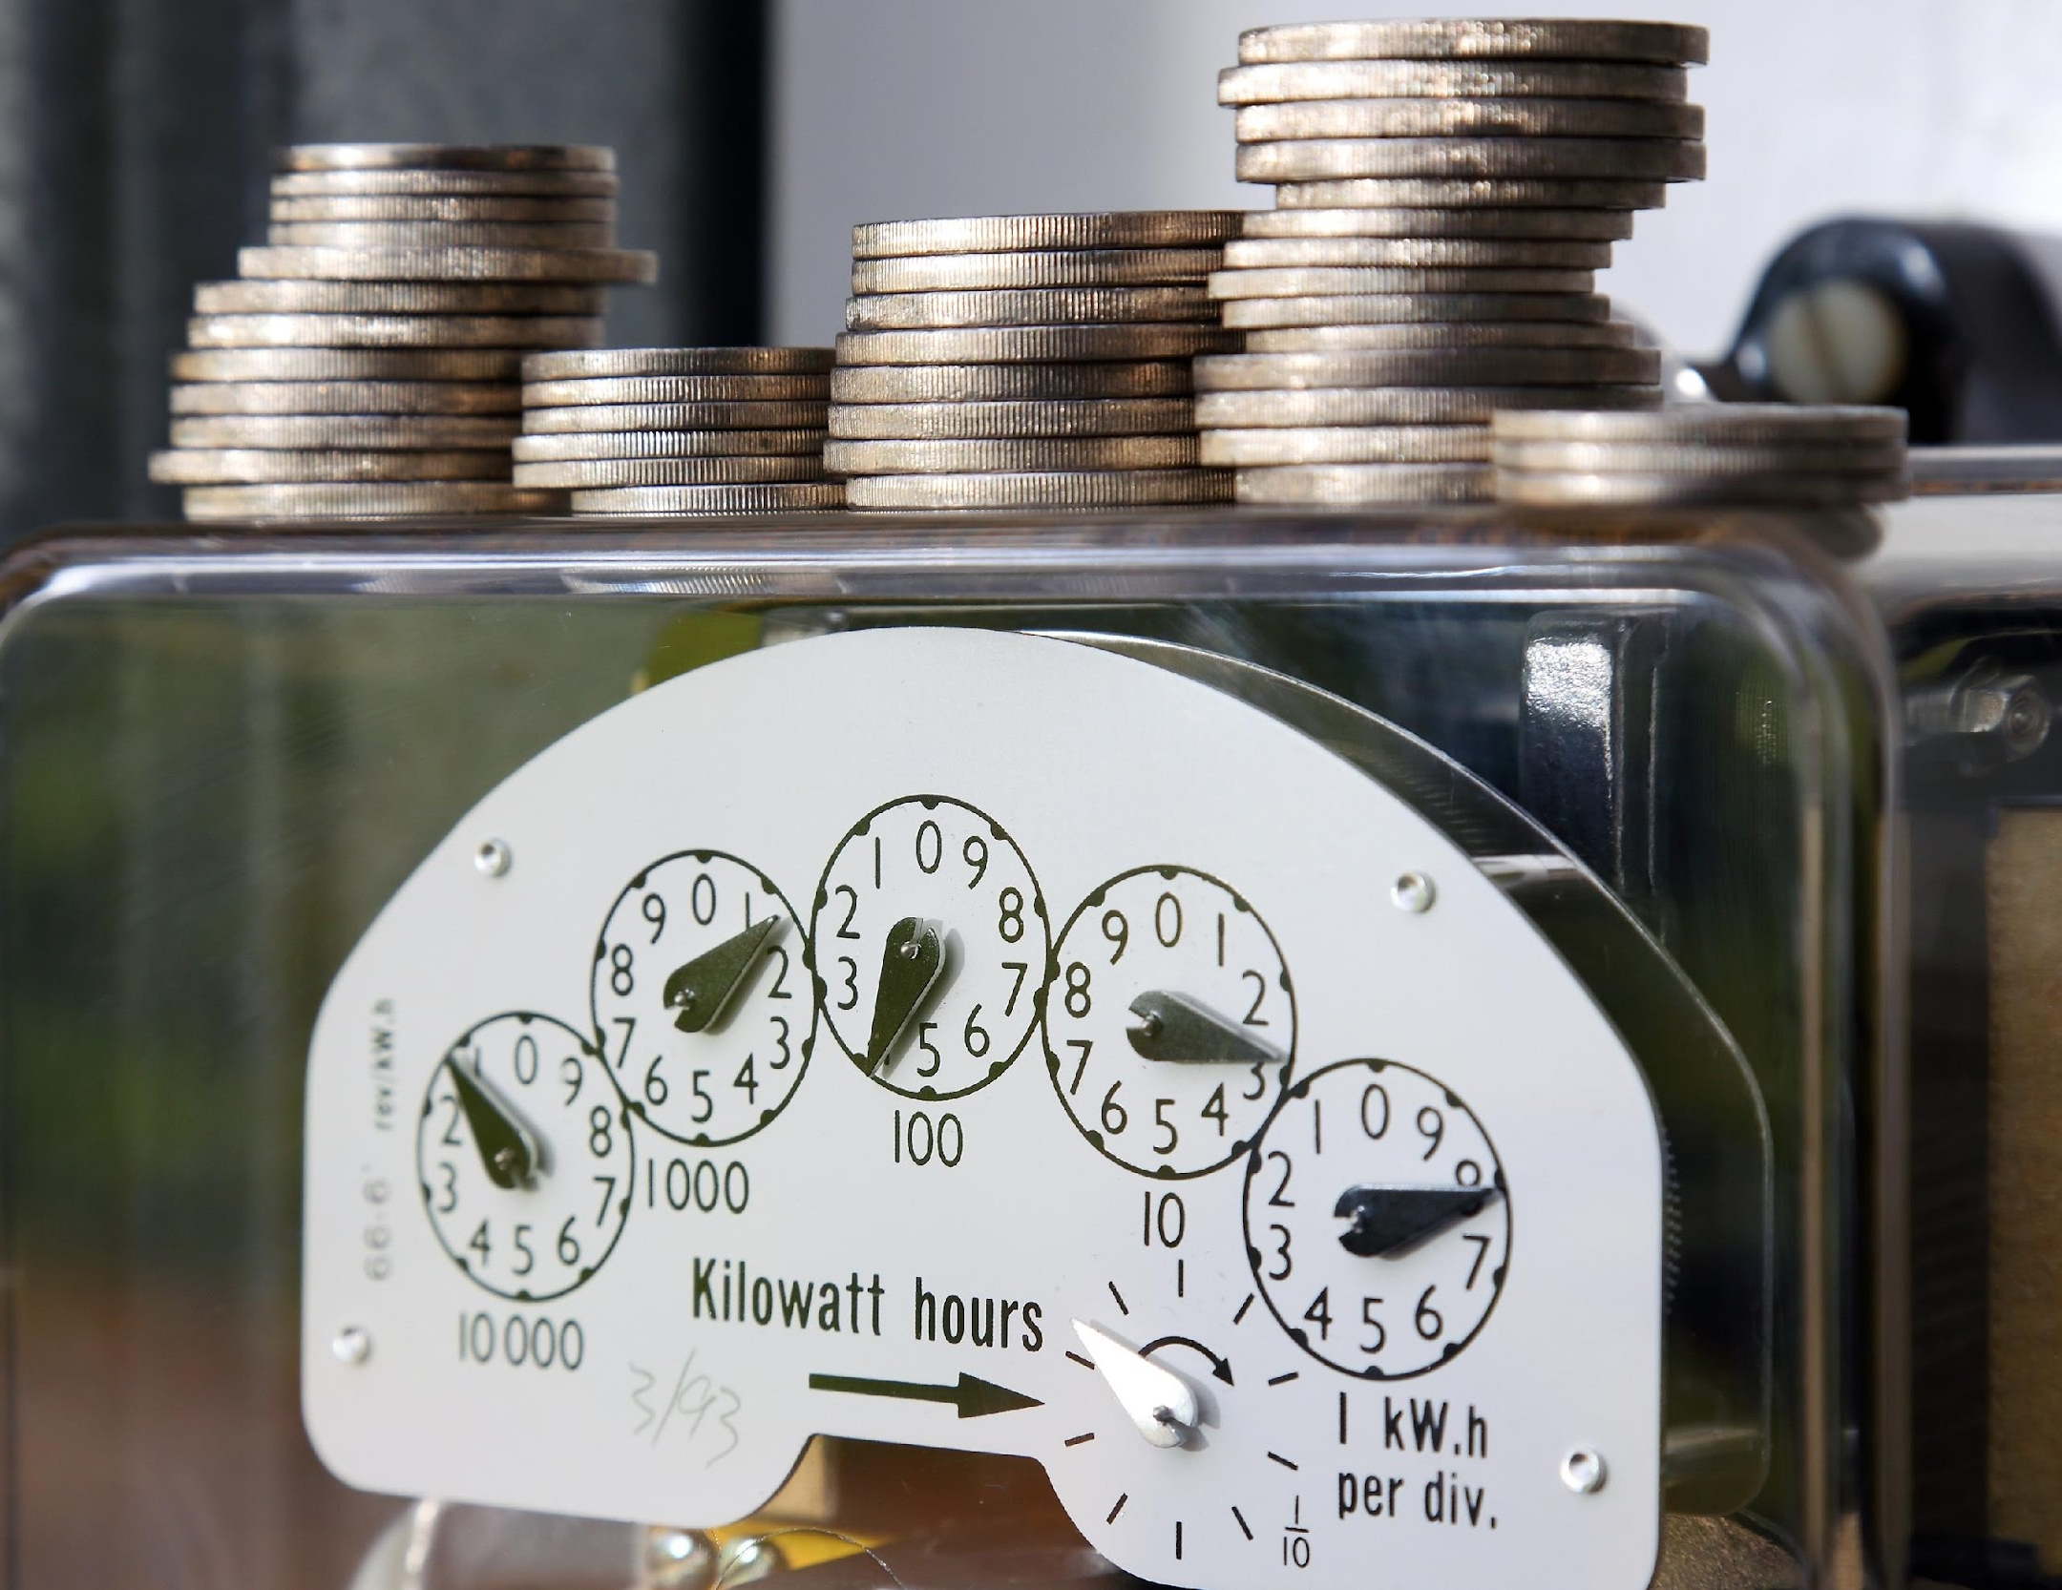
Inflation Reduction Act: HOMES Rebates (starting in late 2023/early 2024)
Who?
Single-family homeowners and multifamily building owners
What?
Rebates for energy efficiency
Whole-house approach
Rebate amounts based on energy savings:
$2,000 for 20% energy savings
$4,000 for 35% energy savings
Doubled for LMI households!
Incentives for your WHOLE HOME
Start planning now!
Notes:
The HOMES Rebates are for homeowners and multi-family building owners. This is a whole house improvement rebate, which is determined by either a modeled or a measured approach.
If you're working with a contractor and you use the modeled approach, the contractor will use a software program to determine the overall energy savings of the project you’re taking on. If your project ends up reducing your energy use by 20%, you would be eligible for a $2,000 rebate. If the model software shows a 35% energy savings or more, the rebate goes up to $4,000.
For the measured approach, a contractor would come to your home and measure how much energy you currently consume. Then they would complete the energy efficiency improvements you agreed upon, and measure your energy use at the completion of the project. If the energy savings are 20% your rebate will be $2,000. If the energy savings are 35% or more, the rebate is $4,000.
If your household is low or moderate income, those rebates are doubled.

Slide 7
High-Efficiency Electric Home Rebate Act (HEEHRA) (coming late 2023/early 2024)
Eligible Use | $ Limits
Electric Load Service Center Upgrades | $4,000
Electric Stove, Cooktop, Range, and/or Oven | $840
Electric Wiring | $2,500
Heat Pump Clothes Dryer | $840
Heat Pump Heating/Cooling | $8,000
Heat Pump Water Heaters | $1,750
Insulation and Air Sealing | $1,600
Tip: You can combine these incentives with Utility Rebates for additional savings!
Up to $14,000
in rebates!
Notes:
The High-Efficiency Electric Home Rebate Act, or HEEHRA (pronounced here-ah) covers both equipment and installation costs. This slide shows the maximum rebate amount available for each equipment/installation, and these are point of sales rebates. The total amount that you can take advantage of through HEEHRA is $14,000. This is not a tax credit, you don't need to wait to file your taxes or have a tax appetite. These are rebates that you will receive when you purchase the item, point of sale.

Slide 8
High-Efficiency Electric Home Rebate Act
Targets the most money to LMI households.
LMI is based on relative to where you live and household size
Less than 80% of AMI = Low Income. 100% rebate
80-150% AMI = Moderate Income. 50% rebate
LMI
Non-LMI = 150% or more AMI
Do not qualify for upfront rebates
Can utilize tax credits
Non-LMI
Upgrades apply to portable items (window unit heat pumps, induction cooktops, heat pump clothes dryer)
Incentivizes energy retrofits in apartments
Renters
Notes:
The HEERHA rebates also increase for households with low and moderate income. If your household income is 80% of the Area Median Income or lower, you get 100% of these rebates. If your household income is between 80% and 150% of the Area Median Income, these rebates are 50%.
If your income is above 150% of your Area Media Income, you’re not eligible for the HEEHRA program, however you can still use the tax credits, up to 30%.
If you're a renter you can still tap into the HEEHRA program. Think about appliances that are more portable, a window unit heat pump, an induction cooktop, a heat pump clothes dryer, or something similar.

Slide 9
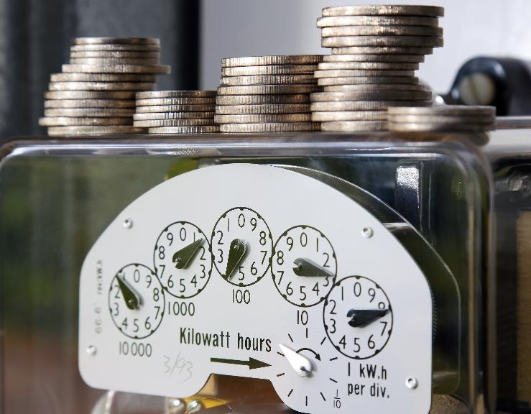
Visit the CERTs Guide to the Inflation Reduction Act to learn more:
on.mncerts.org/IRA
Notes:
The Clean Energy Resource Teams share tools and resources to keep you informed on how to save energy and money with energy efficiency methods and clean energy options. Visit their Guide to the Inflation Reduction Act for updates to help you take advantage of the clean energy incentives within the bill: https://www.cleanenergyresourceteams.org/inflation-reduction-act-what-you-need-know
Thank you, this is the end of the Tax Credits and Rebates for Residents presentation.
Please note: We're sharing resources to assist Minnesotans who are seeking information about federal funding opportunities. These resources are based on preliminary information released by the federal government. Program information may change as more guidance is provided by federal and state governments. For specific information on federal funding, please visit the relevant U.S. Government websites and consult with tax professionals regarding tax incentives that apply to you.

